Slide 1

Programming languages
Power of coding

Slide 2
Why do we need programming languages?
Language is medium for communication. If two parties like to communicate or exchange the thoughts they must know a language. Language should be understandable by both the Parties. For example A wants to talk to B. A only knows English. B only knows Spanish. A and B can’t communicate till both A and B know a common language.
Computer is a machine and we are human beings. Human wants to talk to Computer. Both must know a common language. These languages which are understandable by both Human and Computer are called Programming languages. C, C++, JAVA, FORTRAN, COBOL, Python etc. are the Programming languages.
A person interacts with Computer using instructions. A set of instruction is called program. The art of writing or developing a program is called programming. So programming language is medium using which we can communicate with the Computer.

Slide 3
Why do we need programming languages?
Programming Language is important in our daily life to enhance and increase the power of computers, mobile solutions, and the internet. There are numerous examples you may come to know when you are going to learn a programming language. The actual power of the language is when the right programmer uses it with the right features to solve a problem or for any other specific purpose. Learning a programming language is exciting!

Slide 4
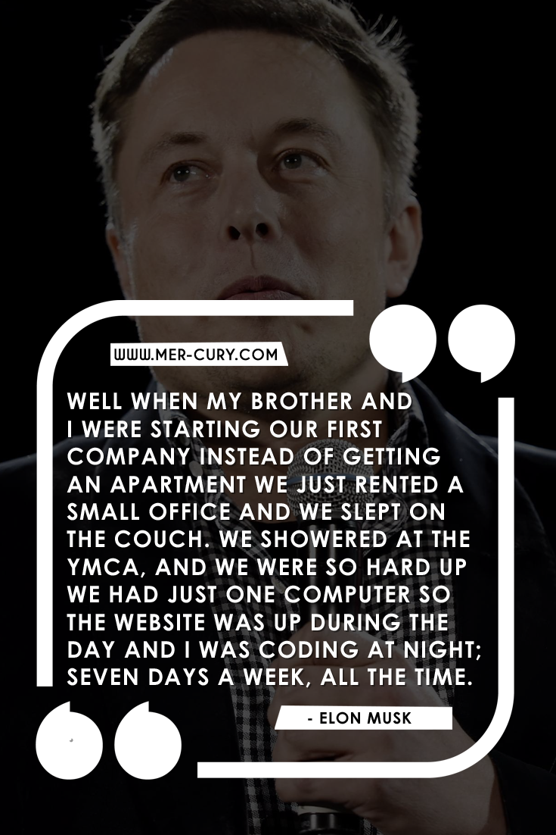
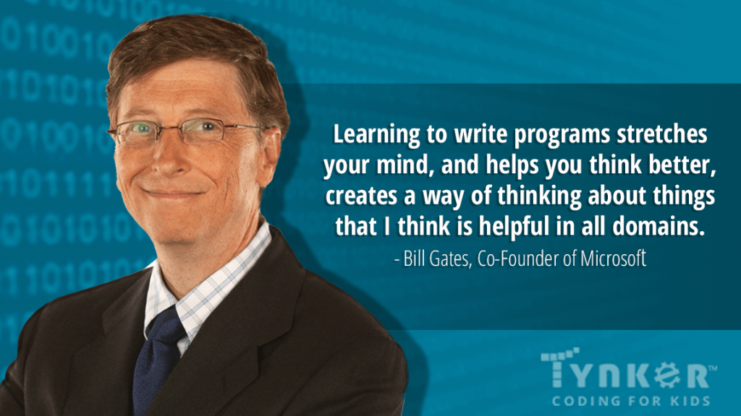
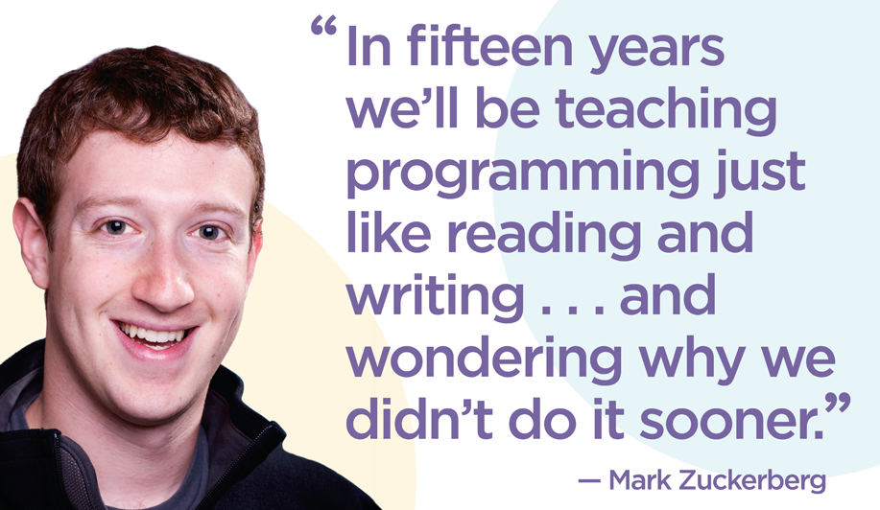
Motivational Coding Quotes from Greatest Entrepreneurs in the World

Slide 5
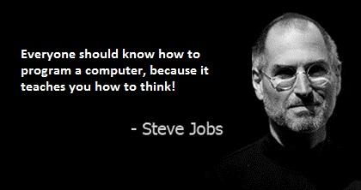
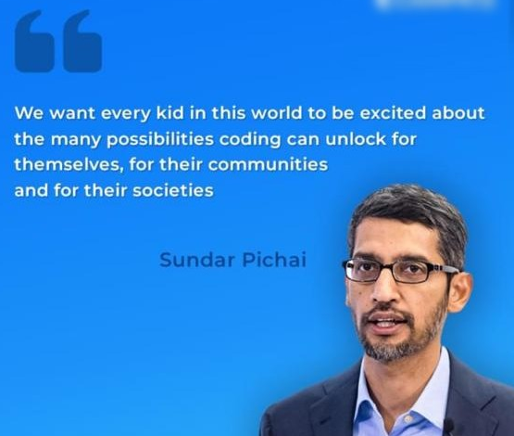
Motivational Coding Quotes from Greatest Entrepreneurs in the World

Slide 6
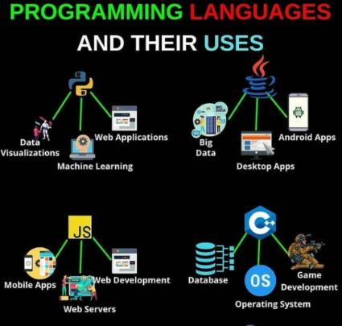
Facts About PROGRAMMING
The first programmer in the world was a woman.
Her name was a Ada Lovelace.
The first computer game was created in 1961.
Nowadays, there are over 700 programming
languages in the world!
In the future knowing how to code will be necessary
as knowing how to write is today.
Learning coding has stunning cognitive-related benefits,
such as problem solving, computational thinking and
creative thinking

Slide 7
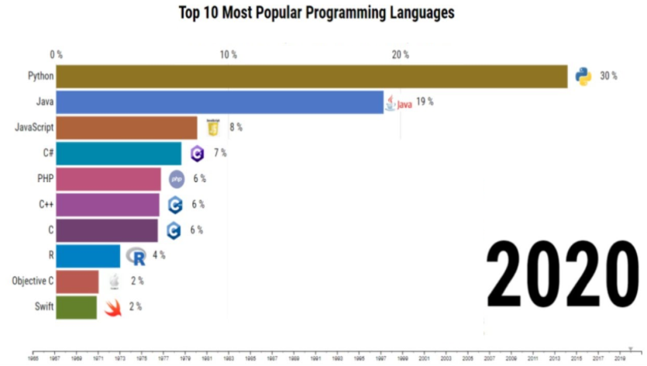
LIST OF DIFFERENT PROGRAMMING LANGUAGES
List of 20 programming languages:
1.C
2.C++
3.Java
4.Visual basic .NET
5.C#
6.PHP
7.Javascript
8.SQL
9.Python
10.Objective – C
11.Delphi/object pascal
12.Ruby
13.Matlab
14.Assembly language
15.Swift
16.Go
17.Perl
18.R
19.PL/SQL
20.COBOL

Slide 8

Every ending is a new Beginning   

